Slide 1
Chapter 4
Organisational
Themes

Slide 2
Systems thinking
System
Boundary
Environment
Open systems
Purpose
Soft systems

Slide 3
Information systems strategy
Efficiency
Cost-benefit
Competitive advantage
Effectiveness
  Redefine the boundaries of particular industries
  Develop new products or services
  Change the relationships between suppliers and customers
  Establish barriers to deter new entrants to marketplaces

Slide 4
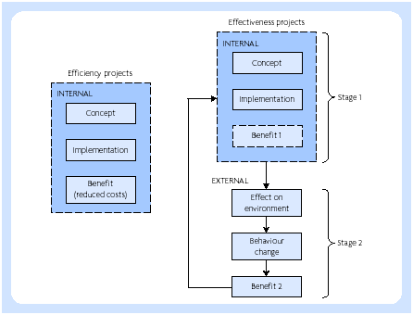
Benefit realisation

Slide 5
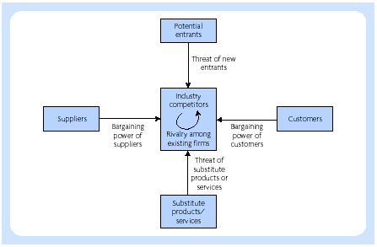
Porter’s framework of competitive strategy

Slide 6
Porter’s framework of competitive strategy
It deals with the industry and competitive dynamics
It highlights that competition is not simply concerned with the action of rivals
It facilitates discussion and is based on sound principles of industrial economics
It focuses on the few dominant forces necessary

Slide 7
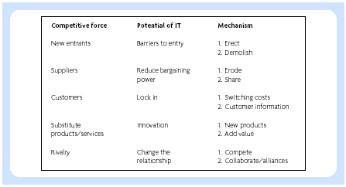
Strategic role of IT (Earl, 1989)

Slide 8
IT strategies
Technology driven model
Competitor-driven model

Slide 9
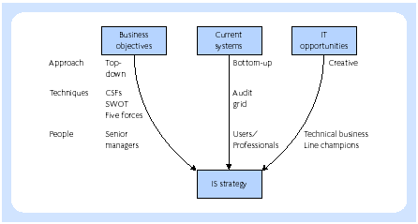
Earl’s multiple methodology

Slide 10
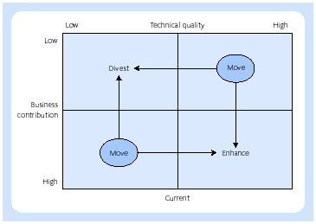
Current systems audit grid

Slide 11
Business process re-engineering (BPR)
The fundamental rethinking and radical redesign of business processes to achieve dramatic improvements in critical, contemporary measures of performance, such as cost, quality, service, and speed (Hammer & Champy, 1993)

Slide 12
Reasons why organisations re-engineer
They face severe commercial pressures and have no choice
Competitive forces present problems unless the organisation takes radical steps to re-align business processes with strategic positioning
Management in the organisation regard re-engineering as an opportunity to take a lead over the competition
Publicity about BPR has prompted organisations to follow the lead established by others

Slide 13
Outcomes of BPR programmes
Flatter organisational structures
Greater focus on customers
Improved teamwork, leading to a more widespread understanding of the roles of others

Slide 14
BPR ‘slash and burn’ (Grover)
Unfortunately, many corporations responded to reengineering by performing major work force reductions under the aegis of reengineering. Such efforts were not strategically driven, and led to firms losing vital components of the work force that reduced their ability to be creative and productive ... Optimizing process at the cost of people has been a major problem of reengineering

Slide 15
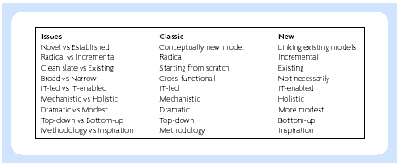
Framework of BPR (Melao and Pidd, 2000)

Slide 16
Information systems planning
Long-term planning
Medium-term planning
Short-term planning

Slide 17
Tasks of information systems strategy group
An assessment of the strategic goals of the organisation, which could be long-term survival, increasing market share, increasing profits, increasing return on capital, increasing turnover or improving public image
An assessment of the medium-term objectives to be used as a basis for allocating resources, evaluating managers’ performance, monitoring progress towards achieving long-term goals, establishing priorities
An appreciation of the activities in the organisation, such as sales, purchasing, research and development, personnel and finance

Slide 18
Tasks of information systems strategy group (continued)
An appreciation of the environment of the organisation, that is, customers, suppliers, government, trade unions and financial institutions, whose actions will affect business performance
An appreciation of the organisational culture relating to values, networks and ‘rites and rituals’
An appreciation of the managerial structure in terms of the layers of management or matrix structure, types of decision made, the key personnel and types of information needed to support the key personnel in their decision making
An analysis of the roles of key personnel in the organisation

Slide 19
Planning guidelines (Lederer and Mendelow, 1989)
Develop a formal plan
Link the information systems plan to the corporate plan
Plan for disaster
Audit new systems
Perform a cost-benefit analysis
Develop staff
Be prepared to change
Ensure information systems development satisfies user needs
Establish credibility through success

Slide 20
Stages of growth (Nolan)
Scope of the applications portfolio
Focus of the IT organisation
Focus of IT planning and control
Level of user awareness

Slide 21
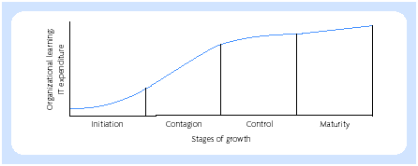
Stages of growth

Slide 22
Stages of growth (Hirschheim, et al. (1988)
Delivery
Re-orientation
Re-organisation

Slide 23
Stages of growth (Galliers and Sutherland, 1991)
Ad hocracy
Starting the foundations
Centralised dictatorship
Democratic dialectic and co-operation
Entrepreneurial opportunity
Integrated harmonious relationships

Slide 24
Flexibility (Evans, 1991)
Pre‑emptive manoeuvres creating options, inflicting surprise or seizing initiatives
Protective manoeuvres insuring against losses, hedging, or creating buffers against adverse conditions
Corrective manoeuvres the ability to recover from adverse situations and learn from mistakes Democratic dialectic and co-operation
Exploitive manoeuvres capitalising on opportunities and consolidating advantages

Slide 25
Flexibility
The designers do not know what the information system is to do.
The organisation may not know how user requirements will develop after the information system has been introduced.
The designers may not be certain that the chosen development methodology will deliver precisely what is required.

Slide 26
Project management (tools and techniques)
Critical path or PERT analysis
CoCoMo
Function point analysis
Project 2000
PRINCE

